Slide 1
Bug Report ppt RESUME FLOW
Name: Pranav Suryawanshi
student code:ft38_538

Slide 2
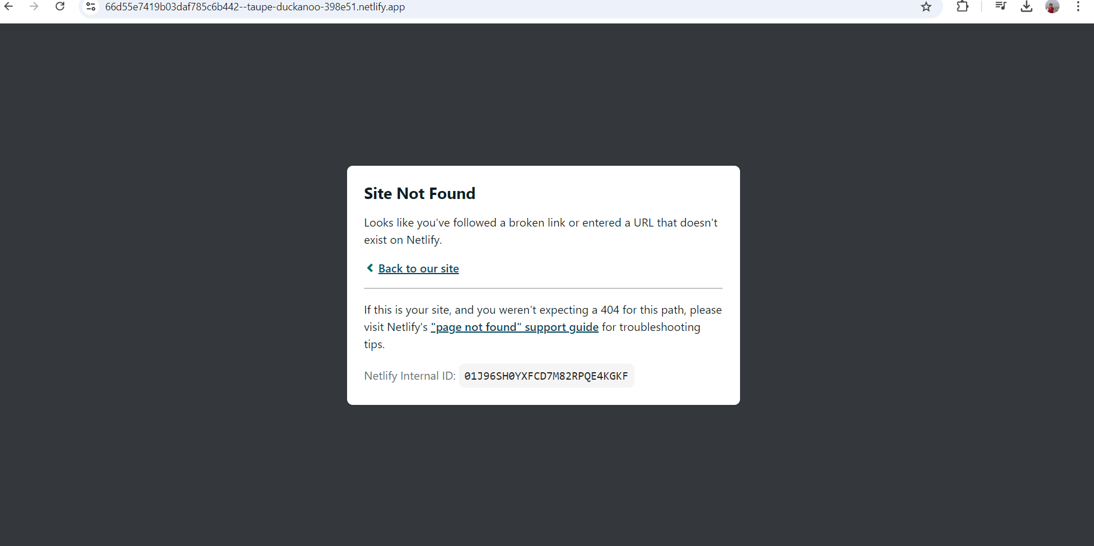
Bug_01: invalid URL is cannot handle

Slide 3
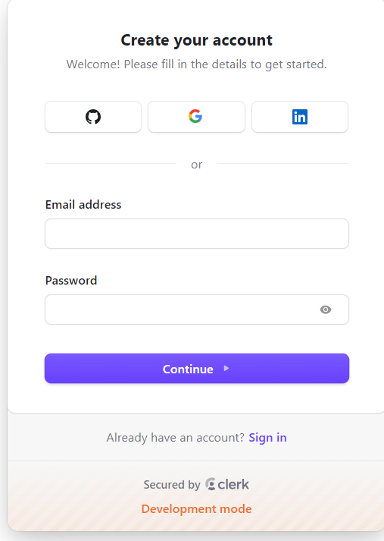
Bug_02:-Asterisk is not present in required field

Slide 4
Bug_03:Logo is not present in signup page
Placeholder should not
guide with user

Slide 5
Bug_04:Placeholder does not present

Slide 6
Bug_06 :-Continue button enabled without enter data

Slide 7
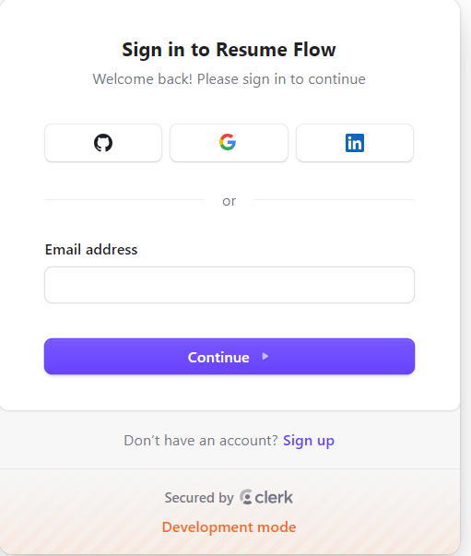
Bug_07:-Asterisked is not present in Sign in

Slide 8
Bug08:-Placeholder is not present in signing page

Slide 9
bug_10:Tooltip is not present in sign-in page

Slide 10
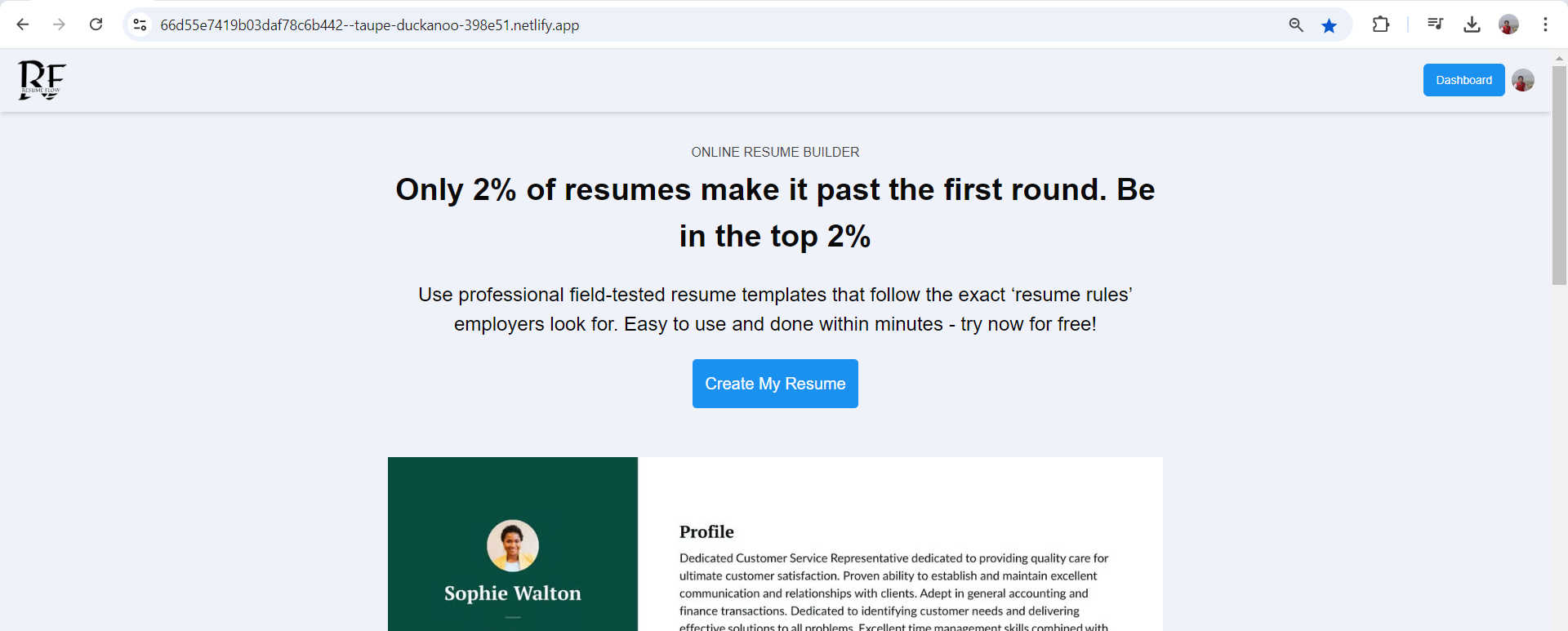
Bug_11:Website is not secure

Slide 11
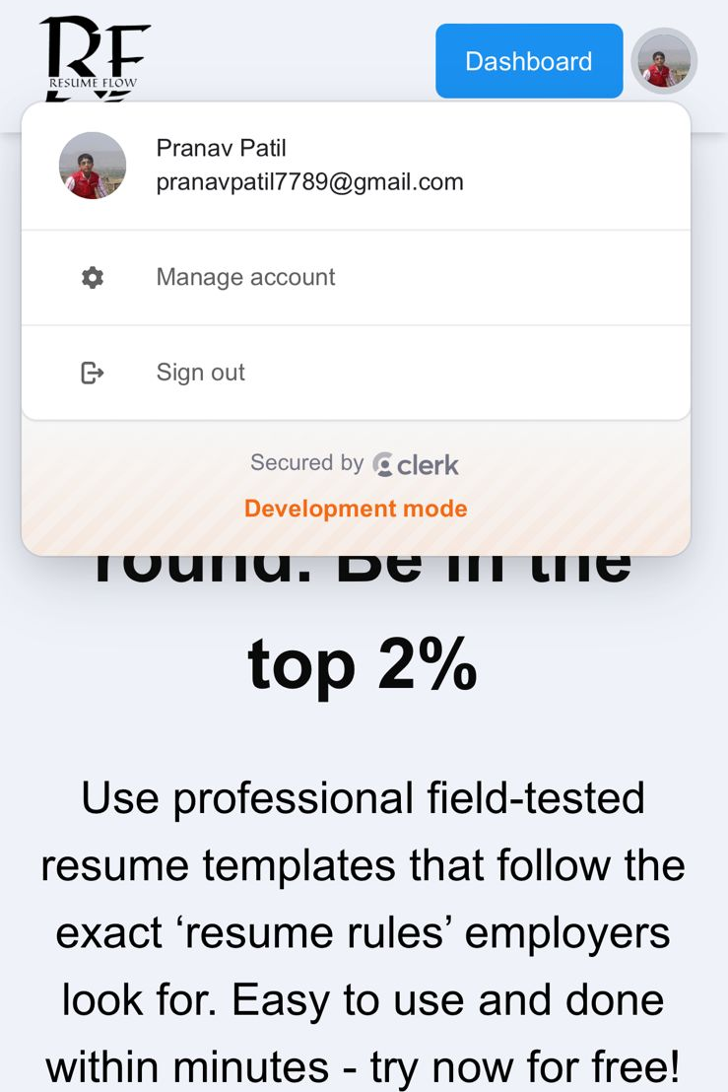
Bug_12:user is not getting sign-out in one browser , when sign-out from other device

Slide 12
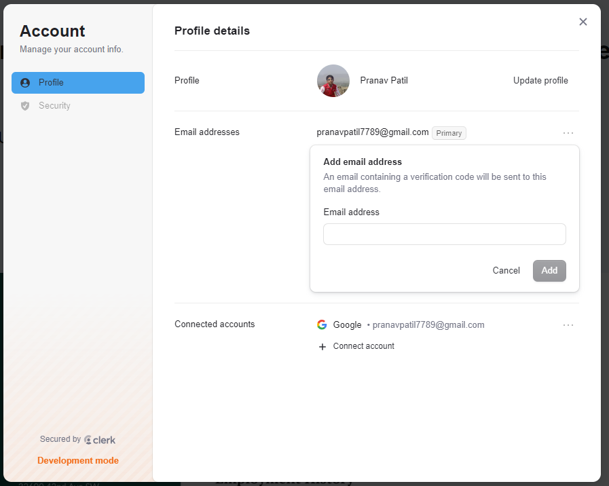
Bug_13:Placeholder does not exist

Slide 13
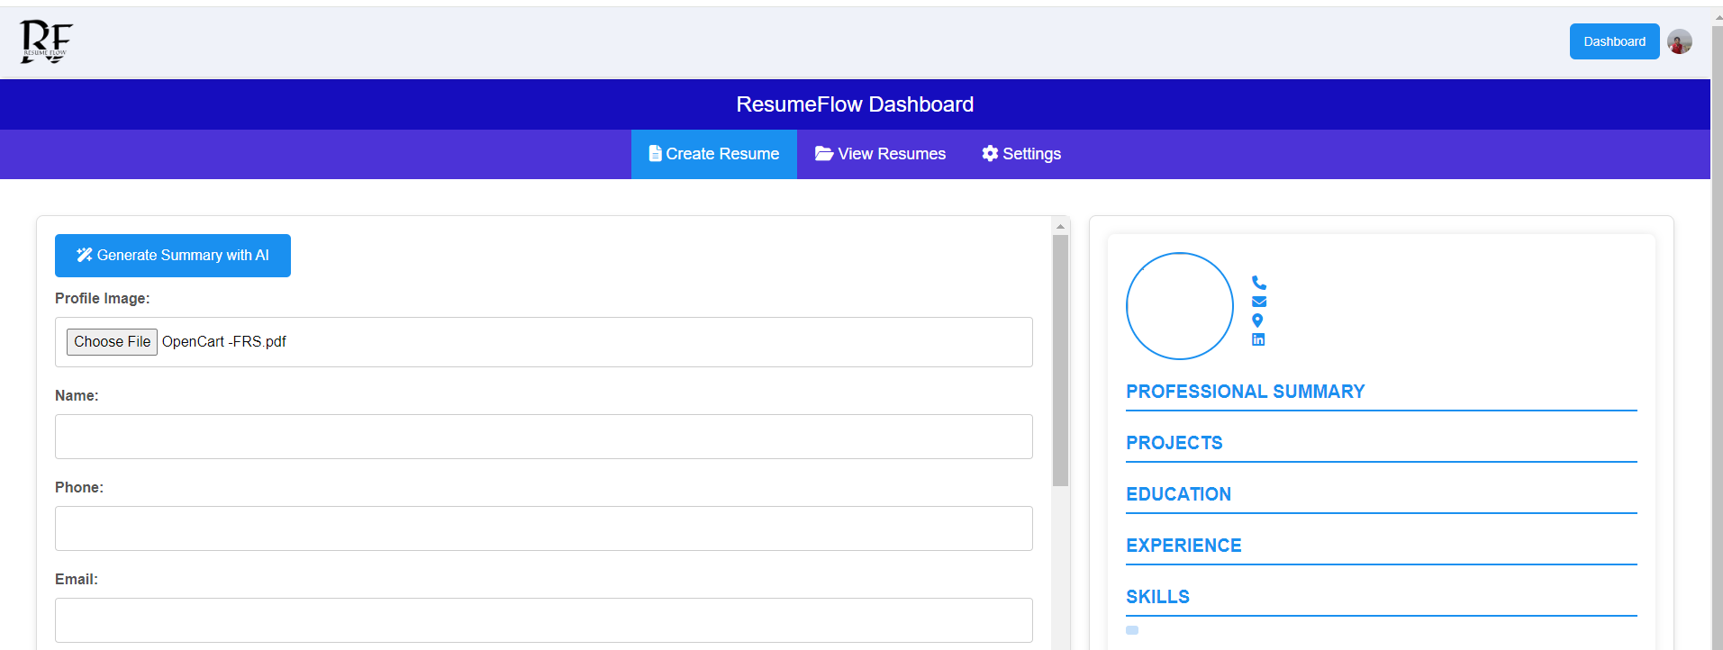
bug_15 invalid file is uploading at resume photo

Slide 14
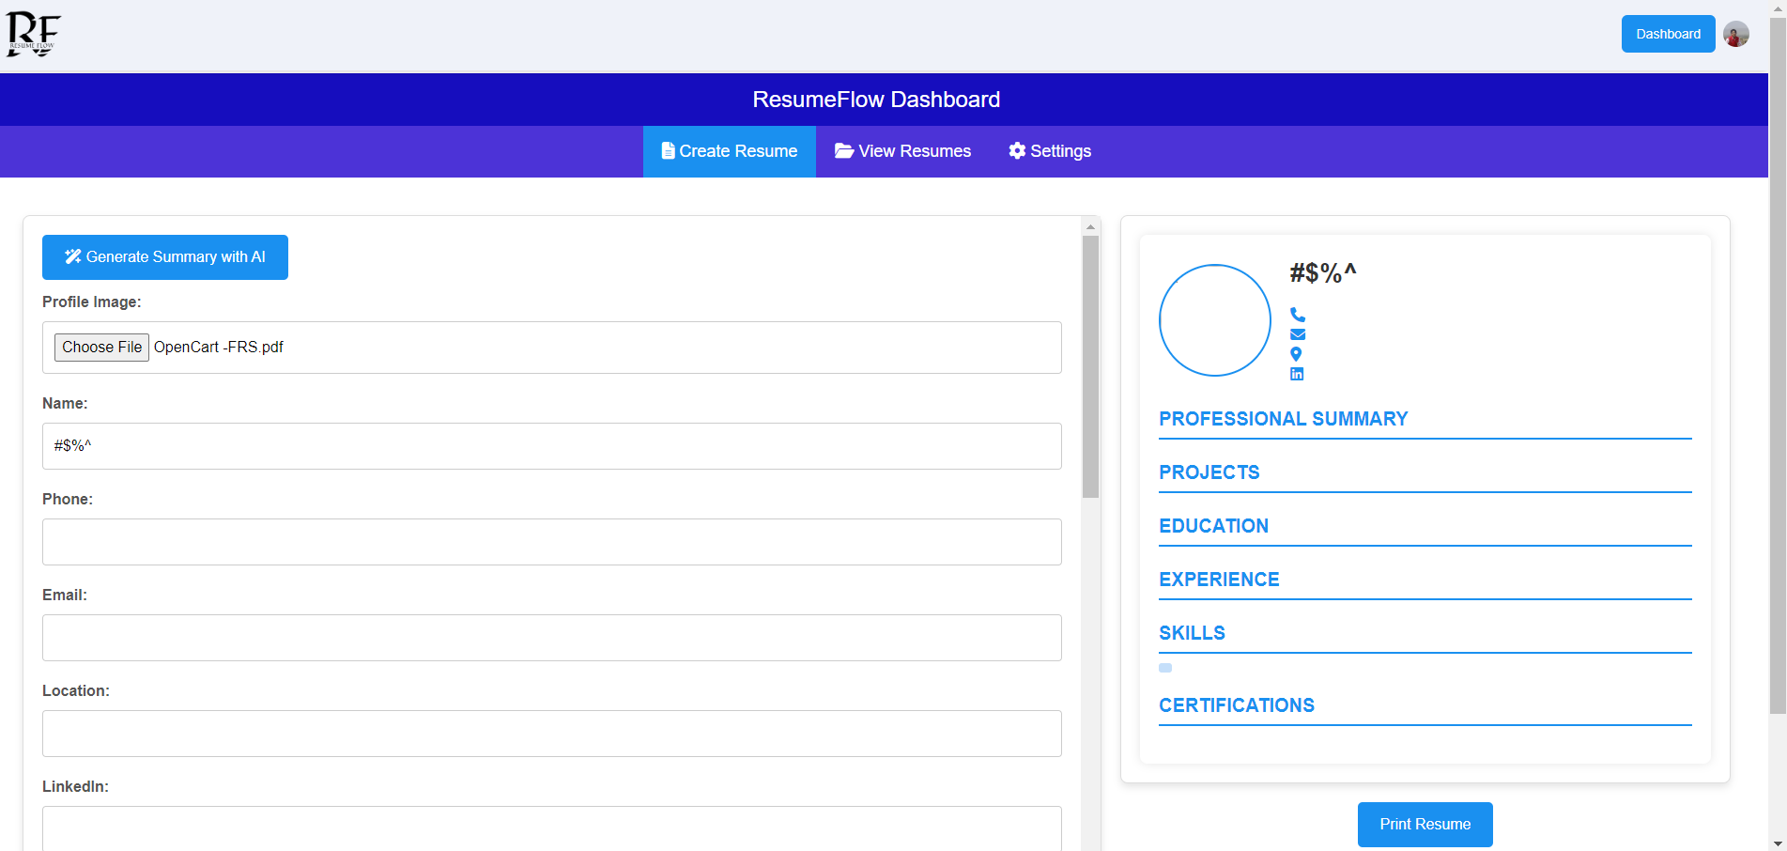
Bug_16:Special Character is accepting in name field

Slide 15
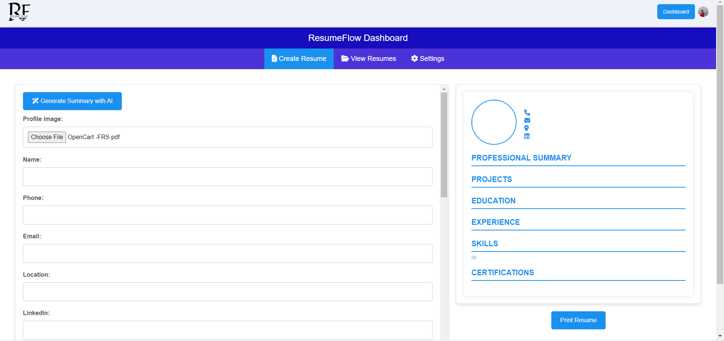
Bug_17:without enter data In all input does not prompt message

Slide 16
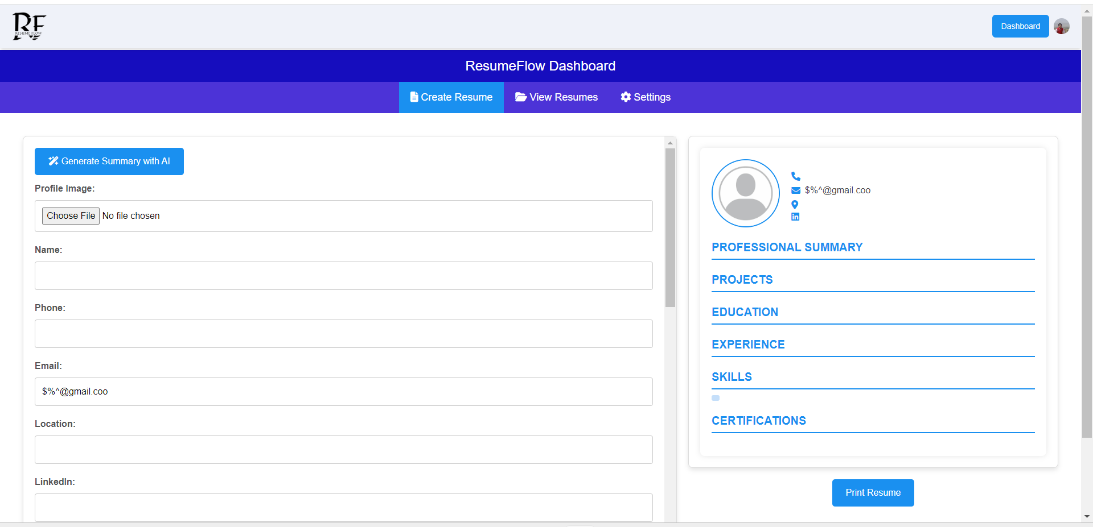
Bug19_invalid email accepting not get prompt

Slide 17
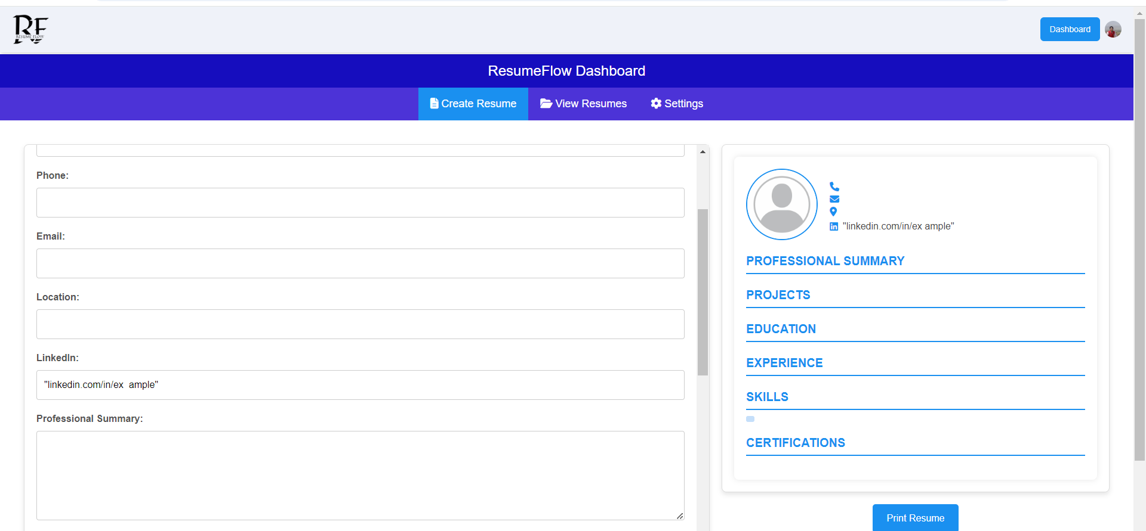
Bug_19:invalid linden URL is accepted

Slide 18
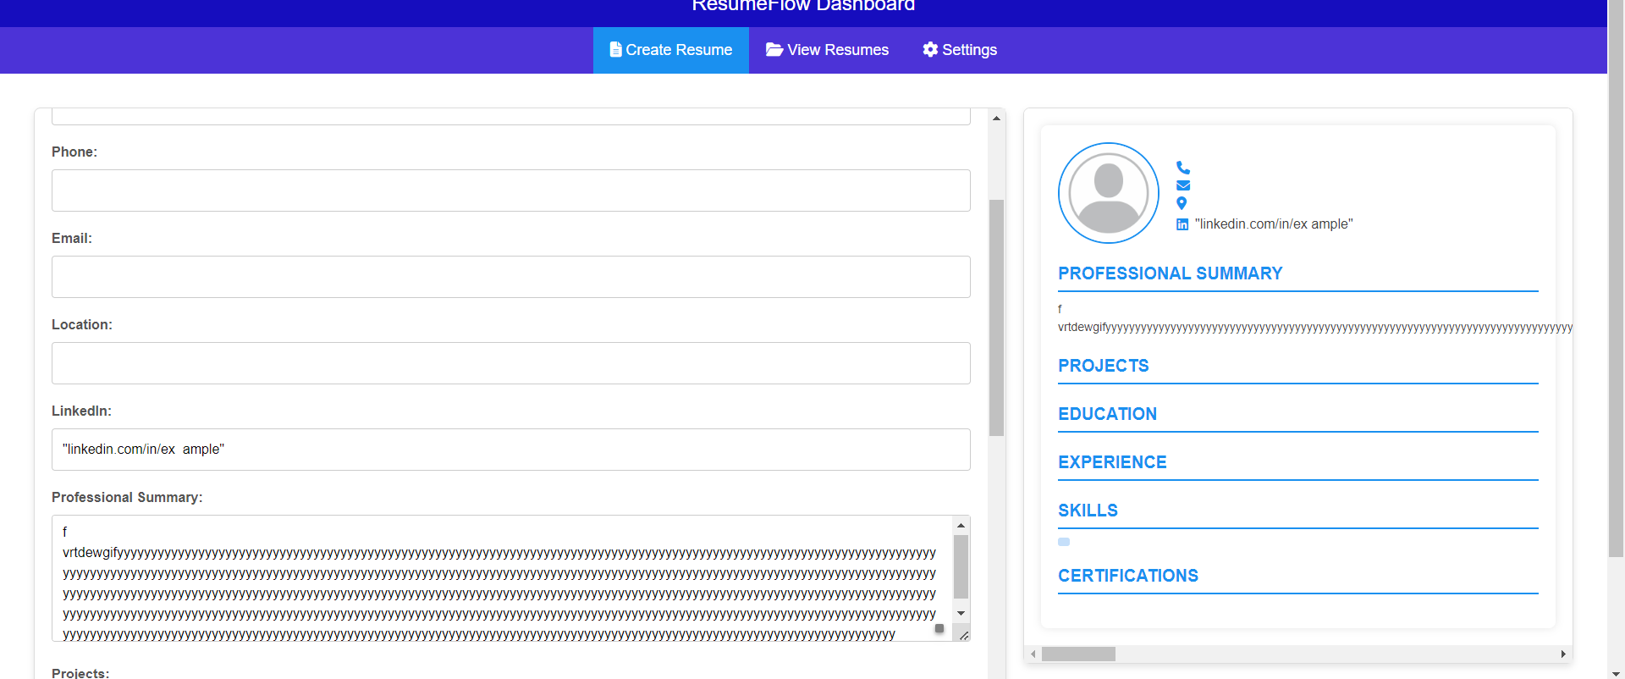
Bug_20:summery filed does not follow boundary

Slide 19
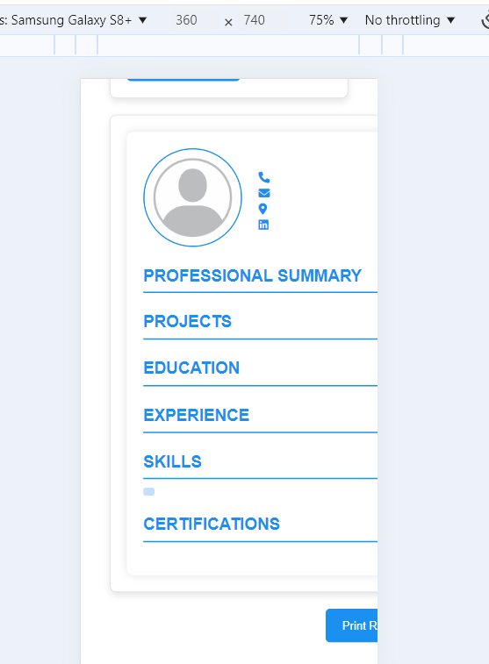
Bug_21: on mobile screen ui/button is not visible

Slide 20
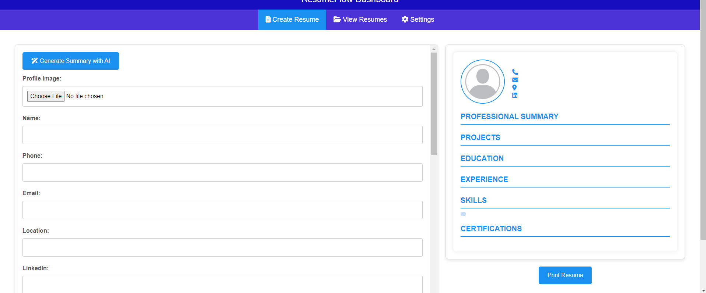
Bug_22:placeholder does not exist

Slide 21
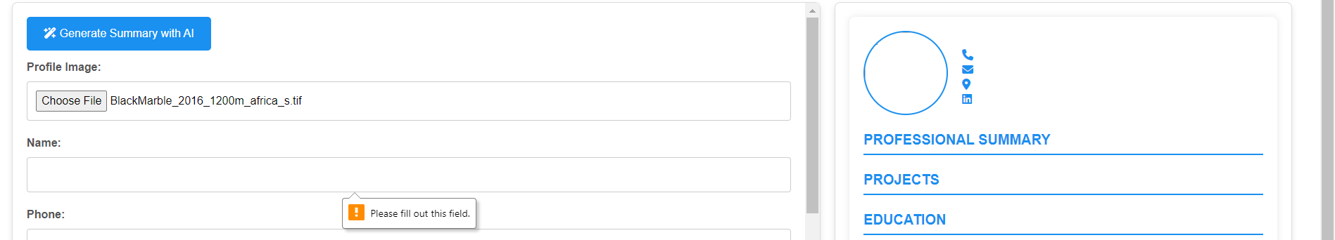
Bug_23:-oversize photo is uploading

Slide 22
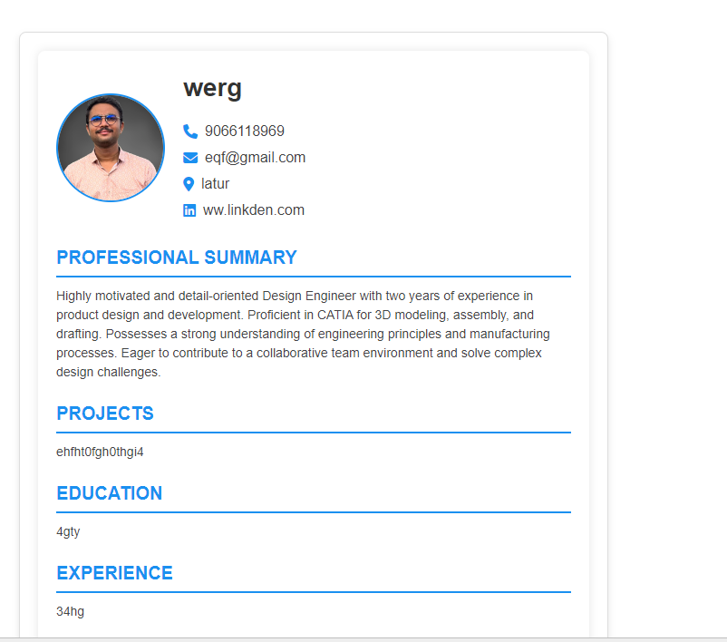
Bug_24:-after save cv user cannot edit it

Slide 23
Bug_26:Tooltip is not present while cv making

Slide 24
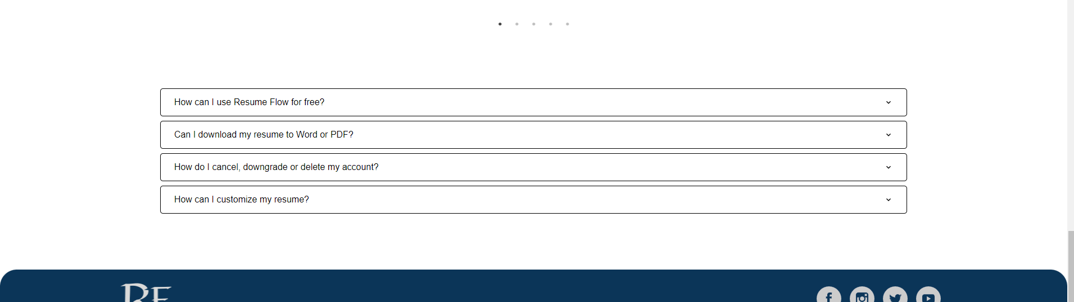
Bug_27:FAQ word is not present

Slide 25
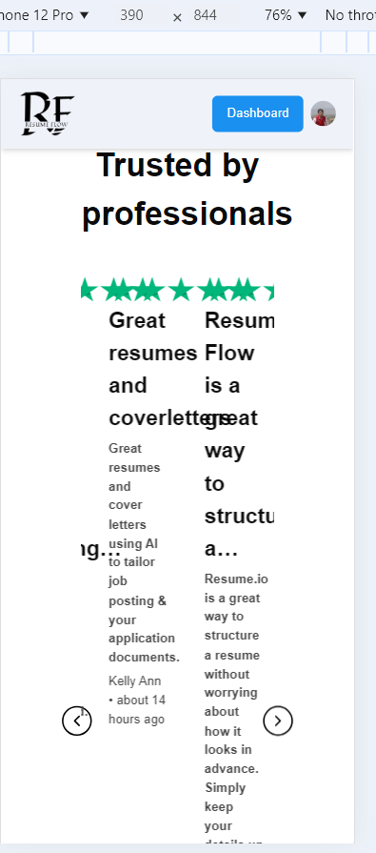
Bug_27:homescreen size is not responsive on other

Slide 26
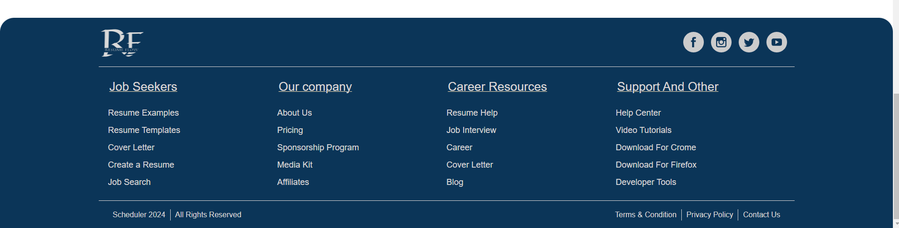
Bug_28:Footer link is not working

Slide 27
Bug_29:Footer social media link is not working

Slide 28
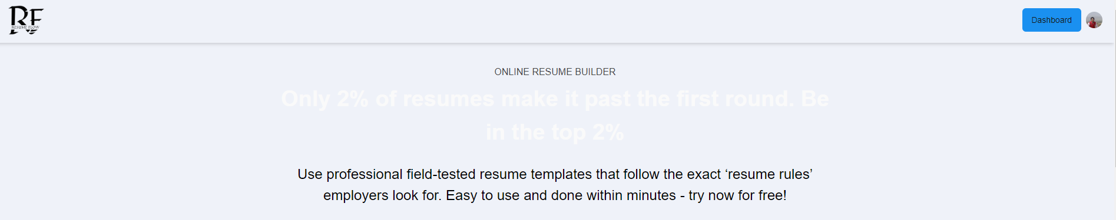
Bug_30: in dark mode homepage wors does not visible properly

Slide 29
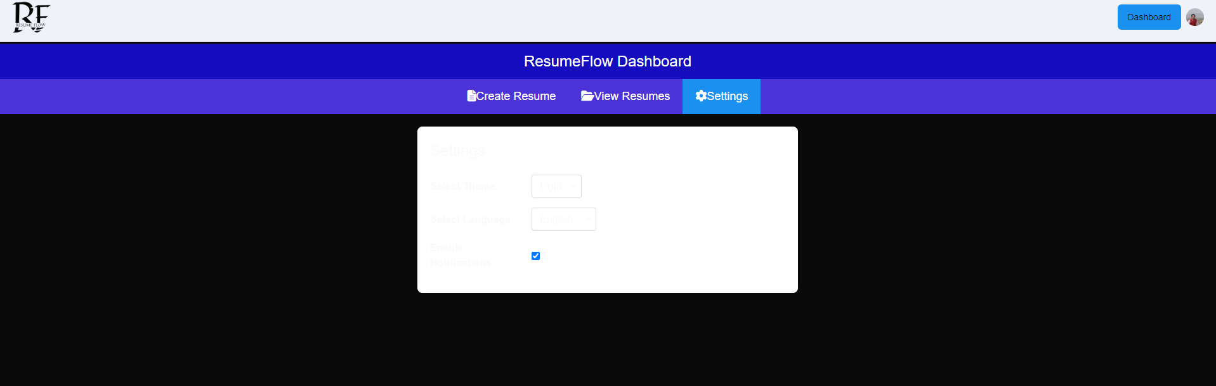
Bug_30: in dark mode homepage wors does not visible properly

